Slide 1
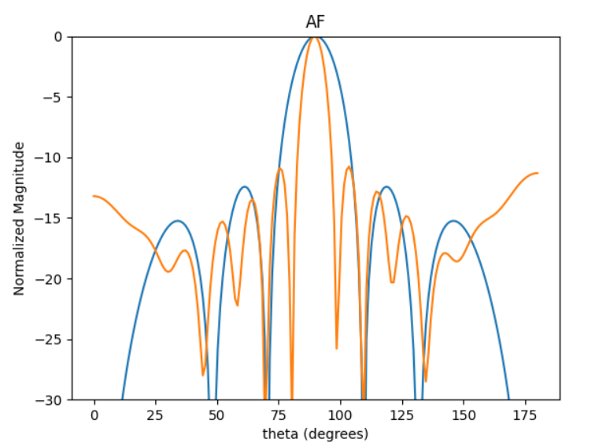
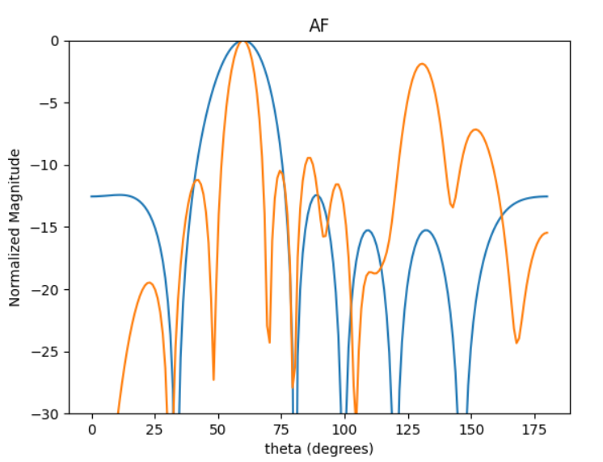
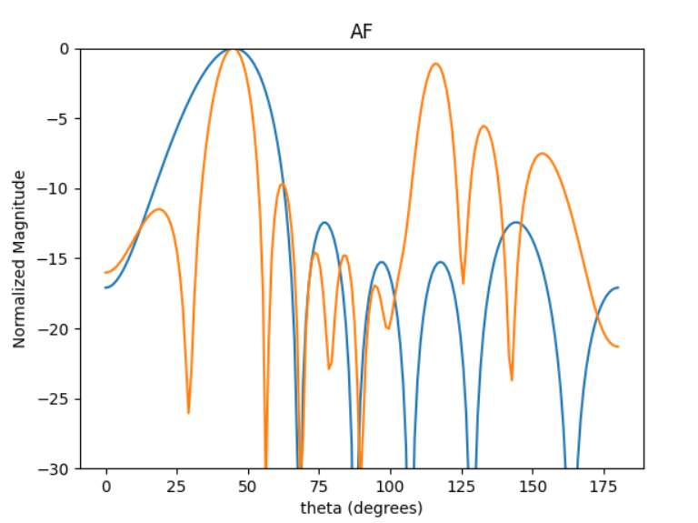
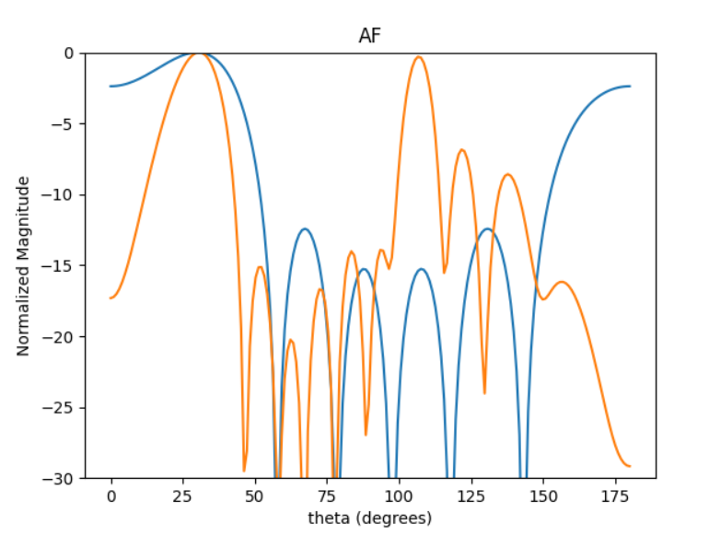
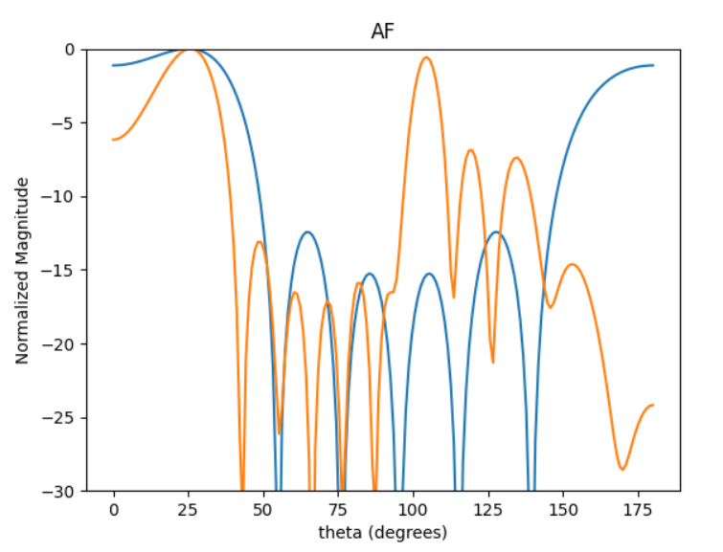
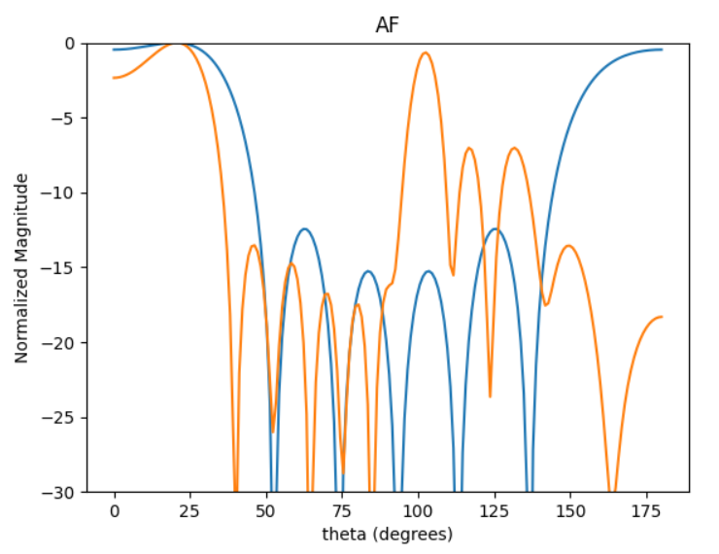
[0.711, 1.019, 0.868, 0.96, 0.772, 0.747]

Slide 2
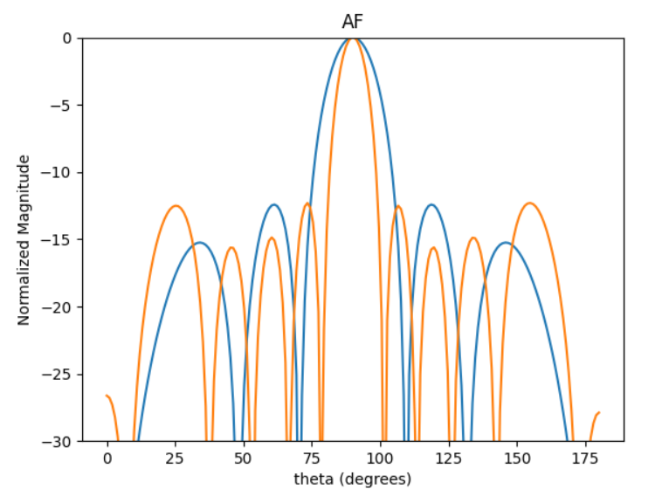
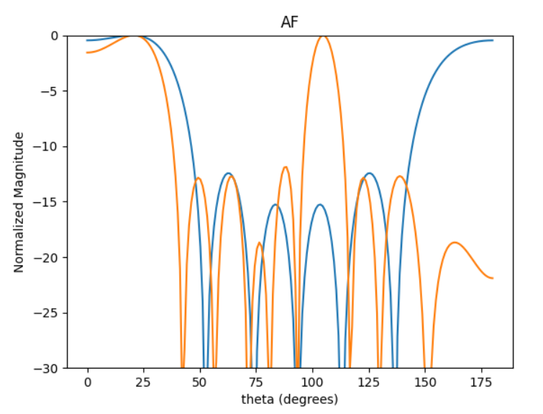
Best SLL
F = SLL_N*DIRR_N/HPBW_N
-12.25 dB

Slide 3
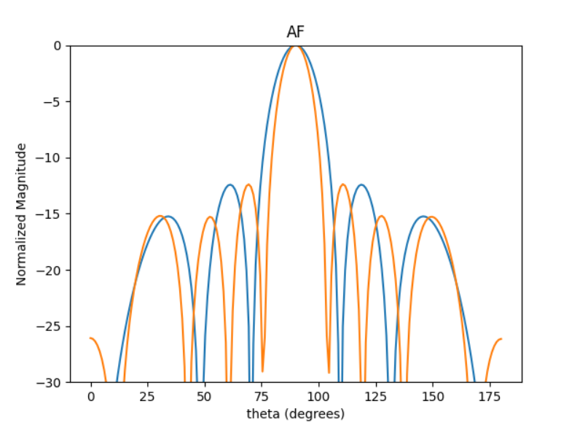
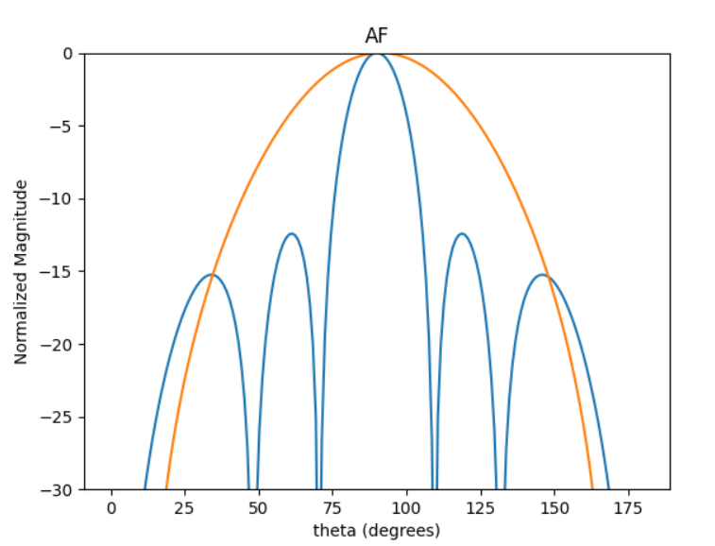
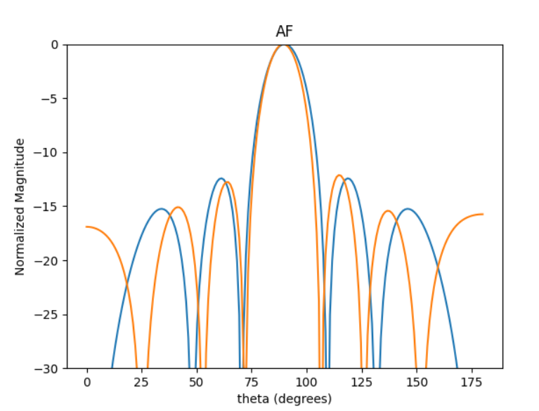
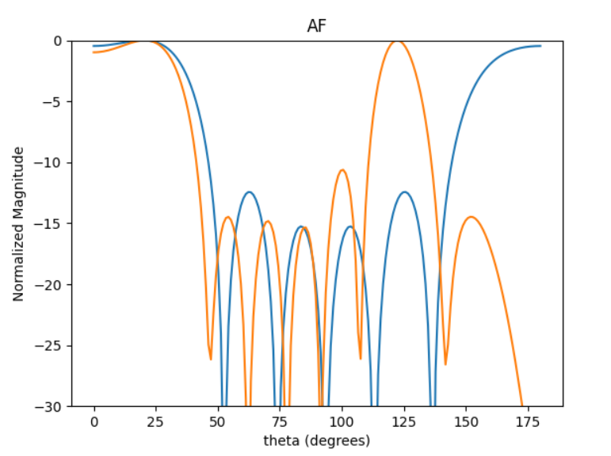
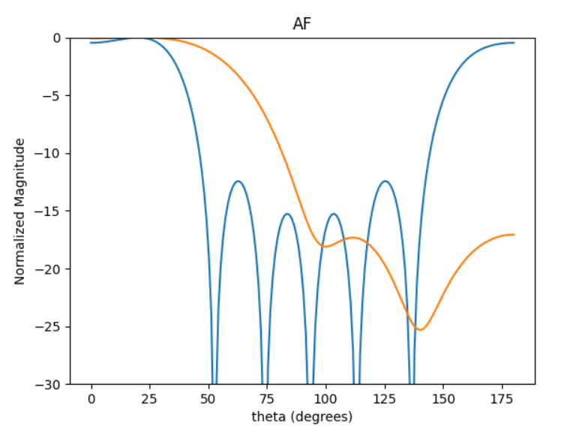
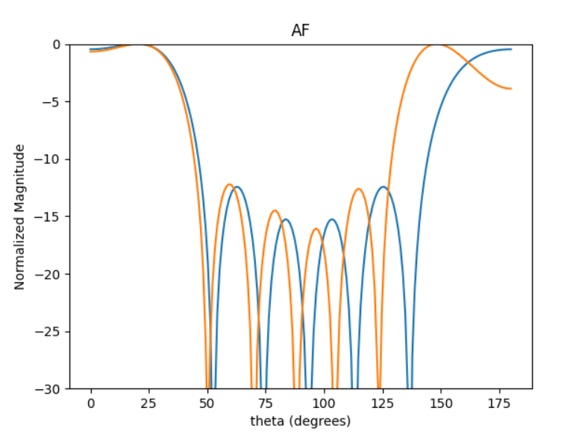
Better HPBW and DIR than 0.5 lambda
Best Directivity:
Best SLL:
[0.68, 0.68, 0.68, 0.68, 0.68]
[0.17, 0.17, 0.17, 0.17, 0.17]
[0.56, 0.56, 0.56, 0.56, 0.56]

Slide 4
[A, B, C, B, A]
[0.1, 0.1, 0.1, 0.1, 0.1]
As C becomes larger more solutions meet the criteria.
Criteria:
At broadside: SLL <-4 and HPBW < 25
At 20DEG: SLL <-3

Slide 5
AVG SPACING

Slide 6
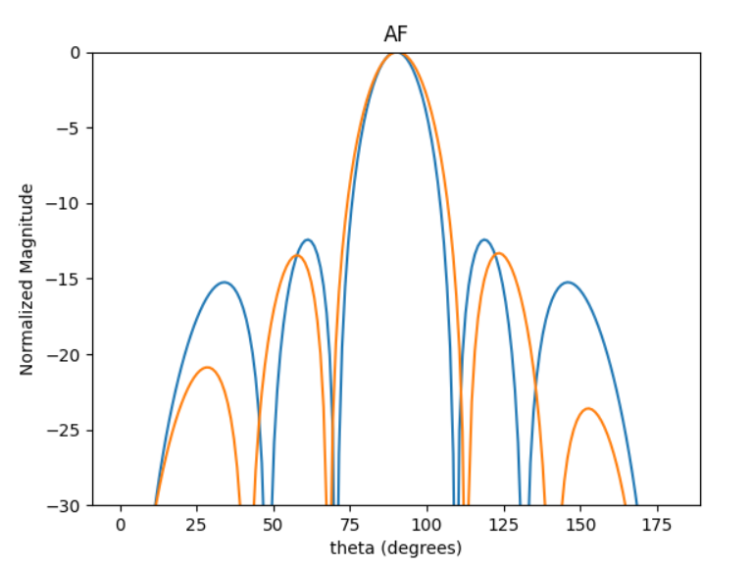
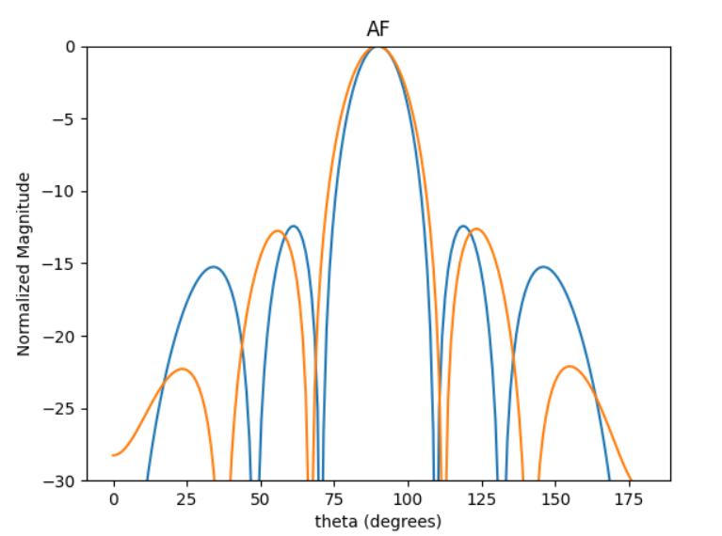
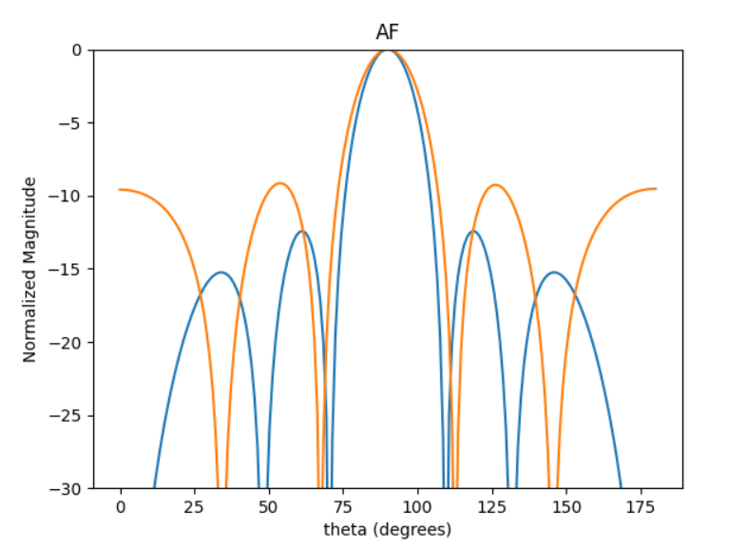
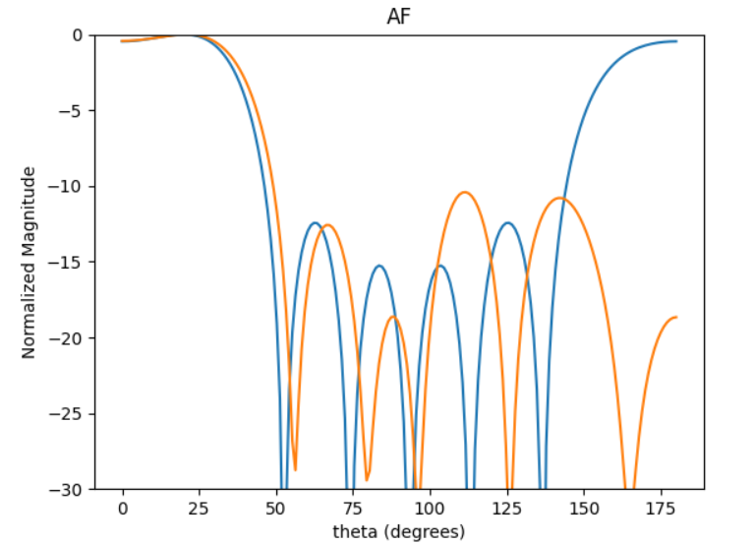
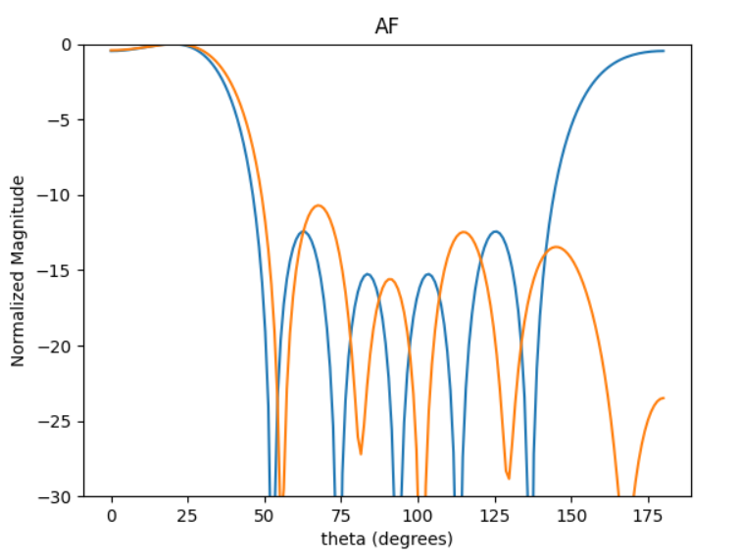
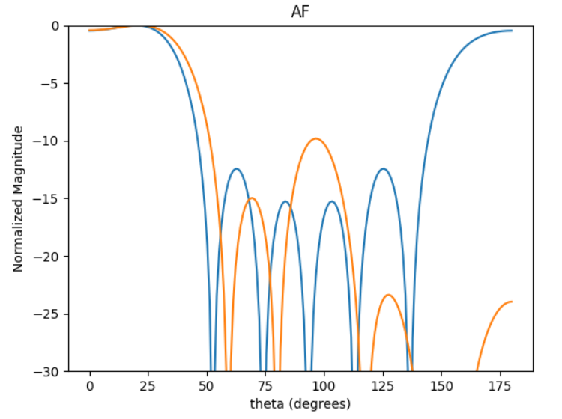
Best avg DIRR :
0.25*DIRR90deg + 0.75*DIRR20deg
BEST DIRR20deg
[0.5, 0.375, 0.5, 0.375, 0.5]
[0.475, 0.375, 0.5, 0.375, 0.475]
[0.275, 0.5, 0.425, 0.5, 0.275]

Slide 7
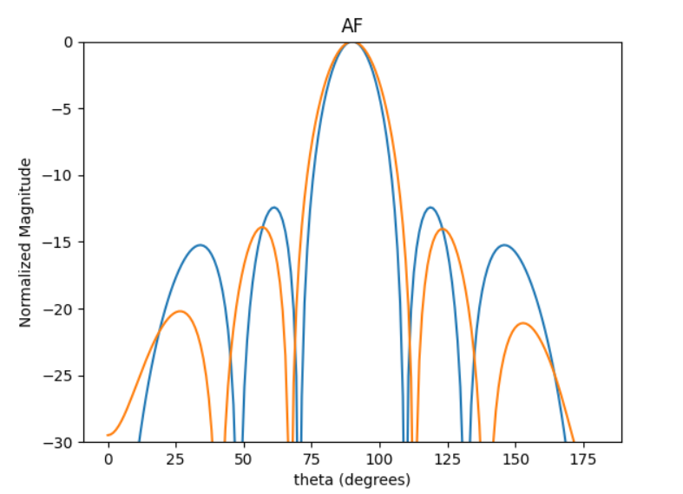
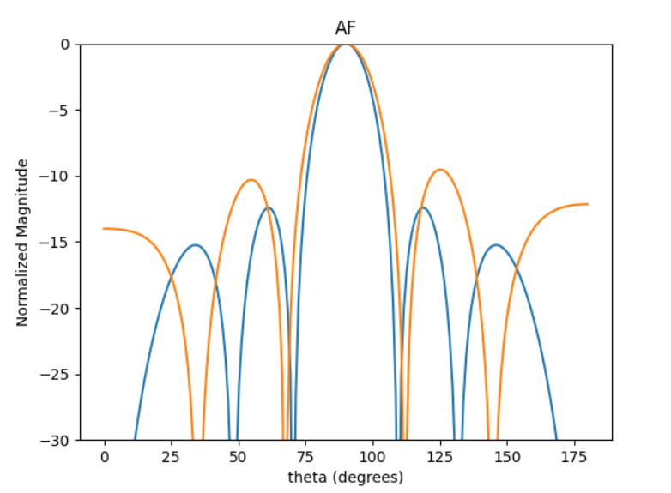
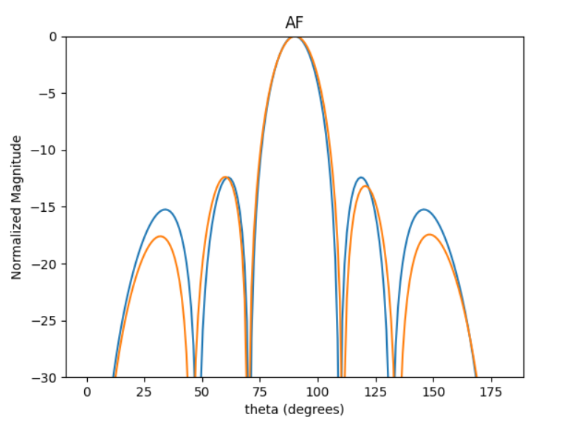
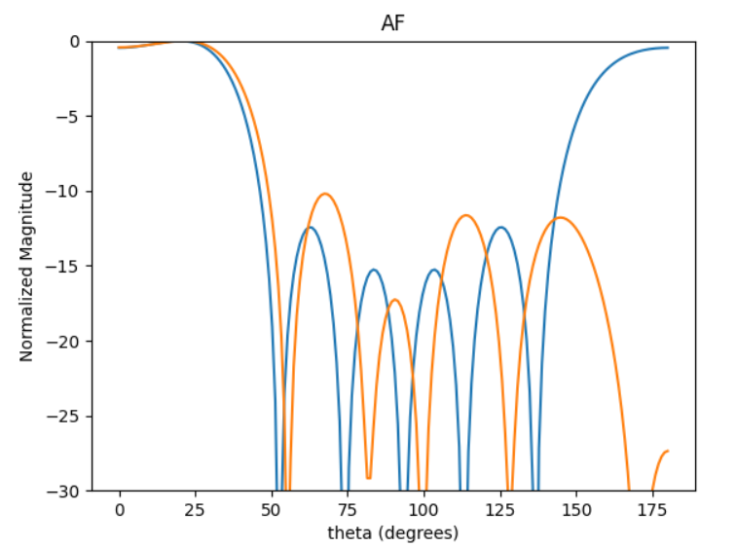
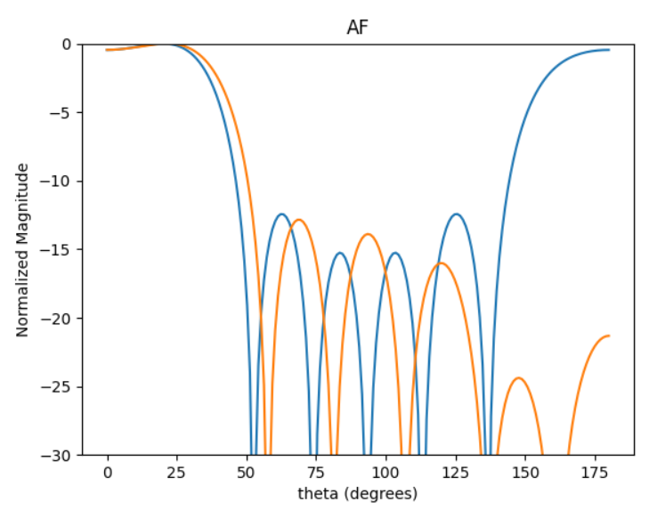
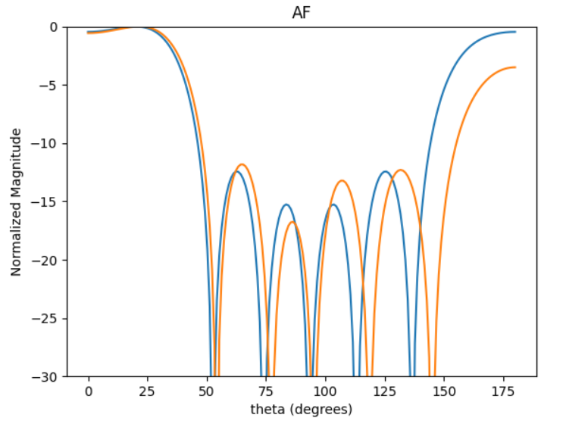
BEST SLLx2 X DIRRx2
Best SLL20deg
SLLx2 * DIRRx2 * AF[0]
[0.5, 0.375, 0.475, 0.375, 0.5]
[0.35, 0.45, 0.475, 0.45, 0.35]
[0.5, 0.45, 0.5, 0.45, 0.5]

Slide 10
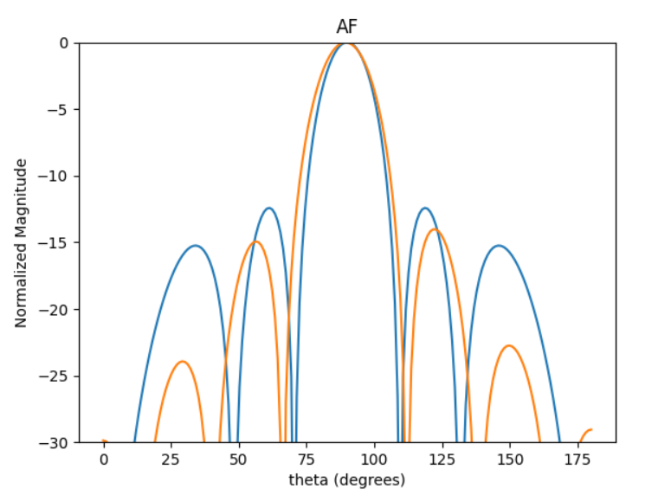
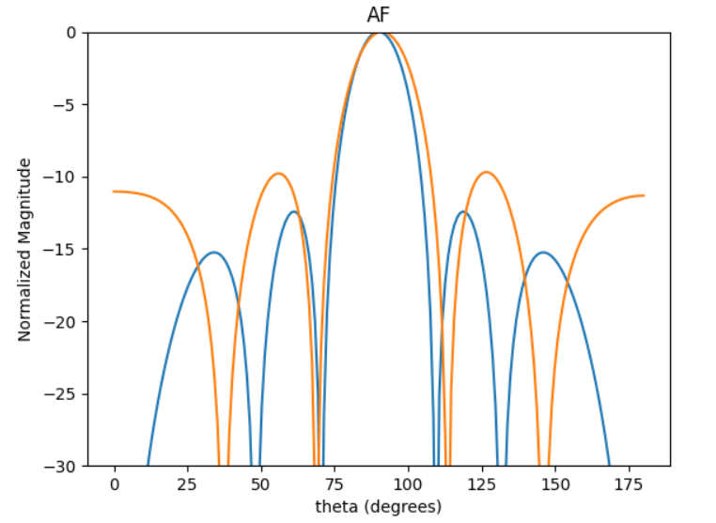
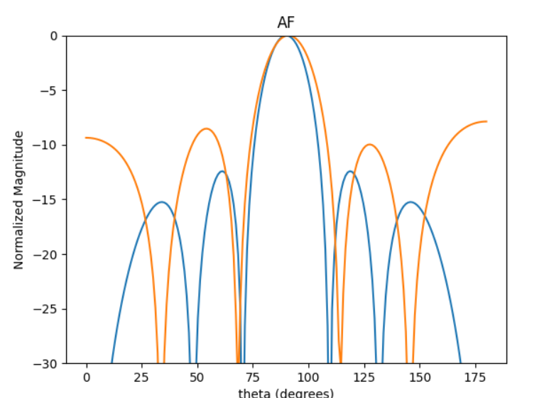
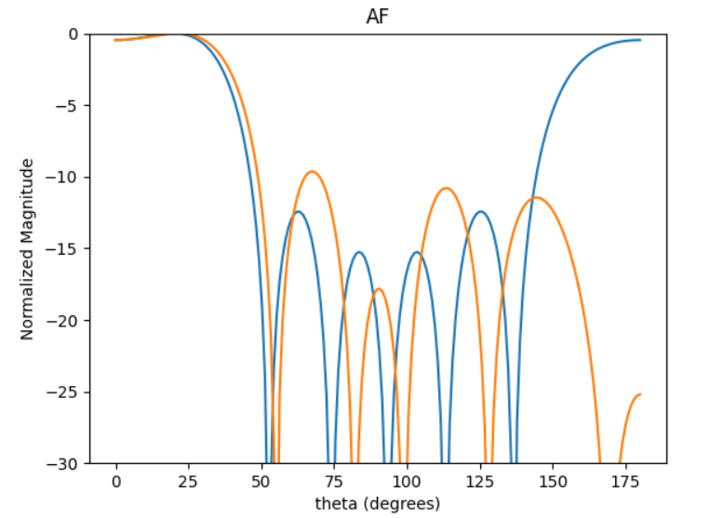
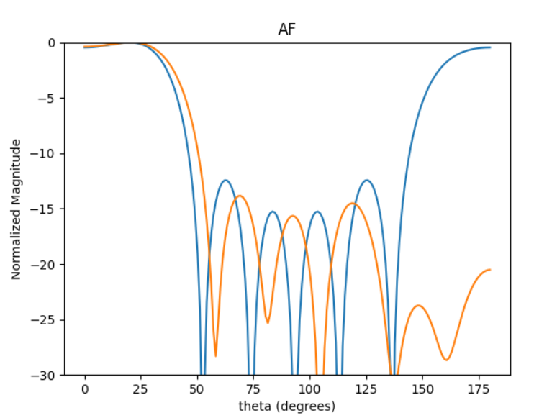
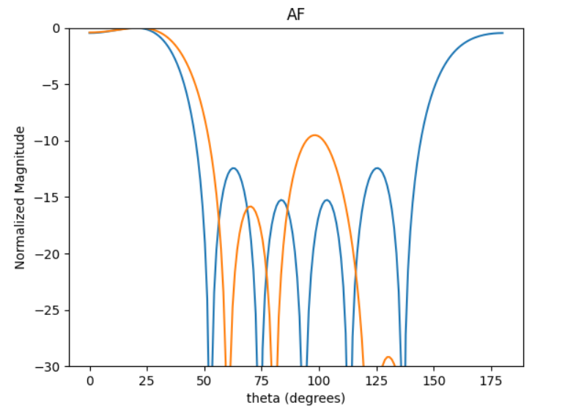
Best avg DIRR (0.5/0.5 & 0.25/0.75)& SLLDIRR:
BEST DIRR20deg
[0.525, 0.35, 0.5, 0.35, 0.525]
[0.325, 0.475, 0.45, 0.475, 0.325]
[0.25, 0.525, 0.375, 0.525, 0.25]

Slide 11
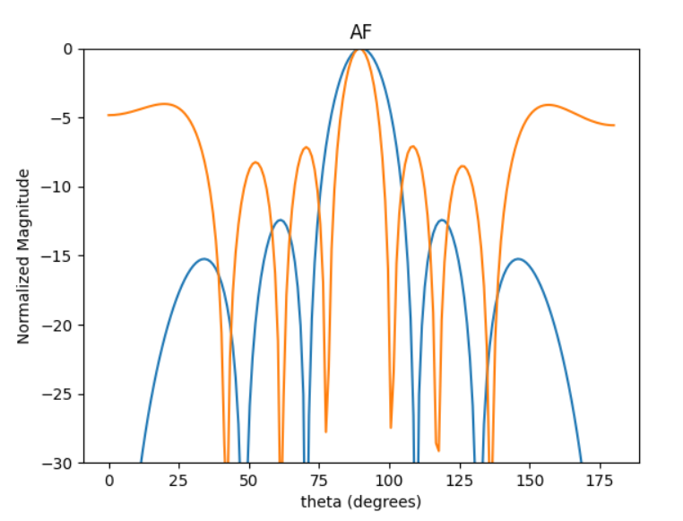
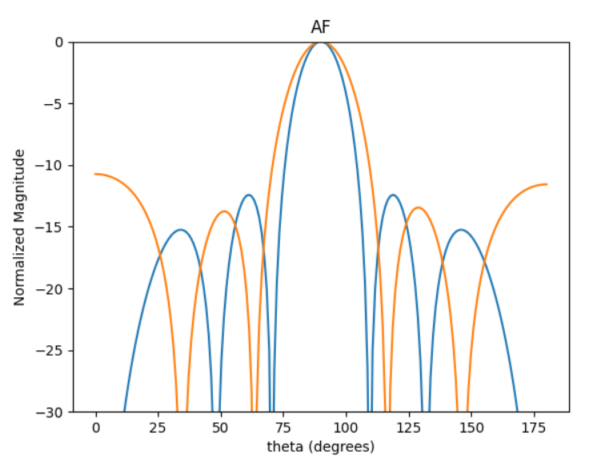
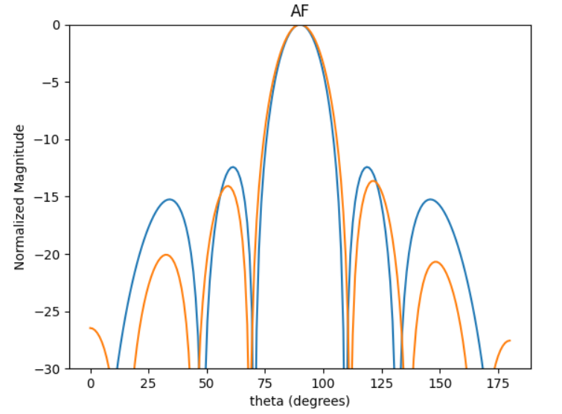
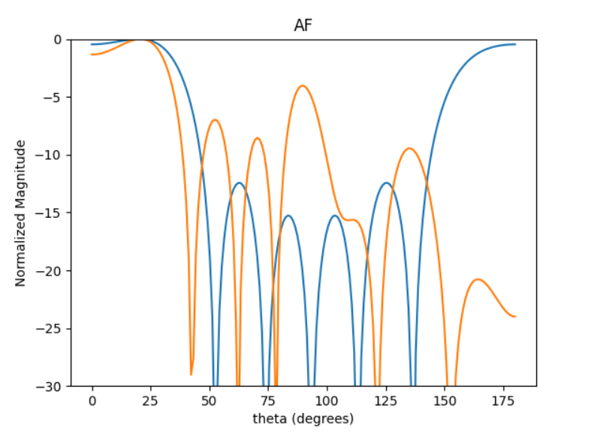
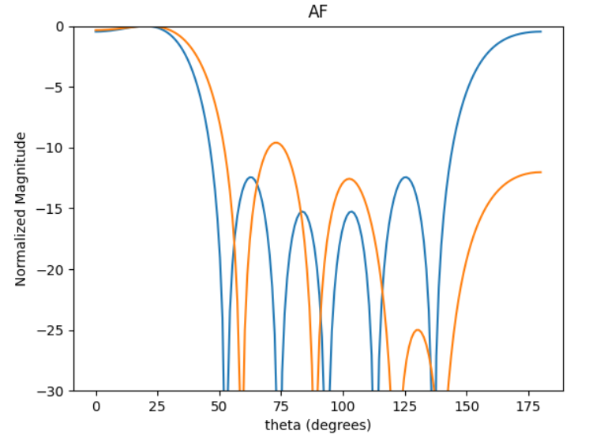
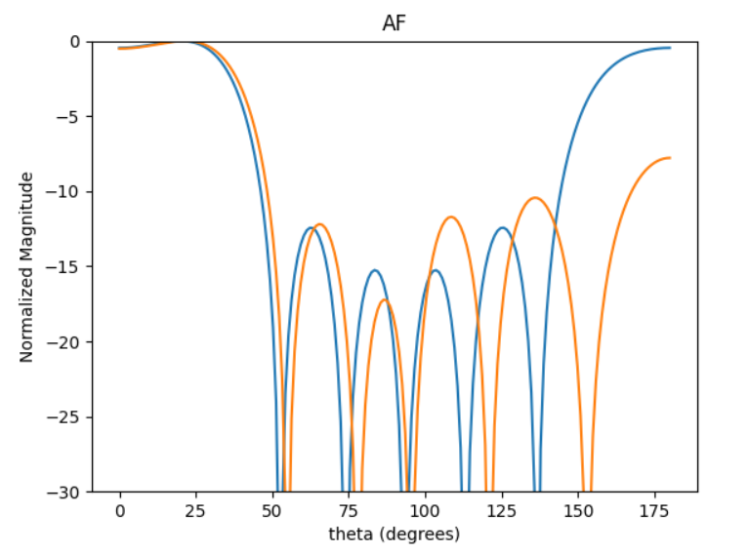
Best HPBW20DEG
Best SLL20deg
SLLx2 * DIRRx2 * AF[0]
[0.375, 0.9, 1, 0.9, 0.375]
[0.35, 0.525, 0.475, 0.525, 0.35]
[0.525, 0.4, 0.5, 0.4, 0.525]

